Slide 1

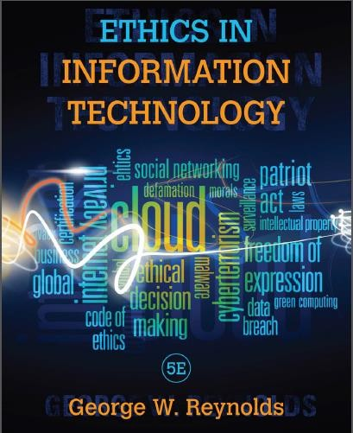
Professional Computing Issues
Chapter 2: Ethics for IT Workers and IT Users
George W. Reynolds
Edited by
Suaad Alarifi

Slide 2
The risk of using information technology has increased, why?
the growth of the Internet,
the ability to capture and store vast amounts of personal data, and
greater reliance on information systems in all aspects of life

Slide 3
Learning Objectives
What key characteristics distinguish a professional from other kinds
of workers, and is an IT worker considered a professional?
What relationships must an IT worker manage, and what key ethical issues can arise in each?
How do codes of ethics, professional organizations, certification, and licensing affect the ethical behavior of IT professionals?
What is meant by compliance, and how does it help promote the right behaviors and discourage undesirable ones?

Slide 4
Profession ةنهم
Requires specialized knowledge and a long and intensive academic preparation
Professionals:
Possess advanced training and experience
Exercise discretion and judgment in their work
Work is not standardized
Contribute to society and assist other professionals
Participate in a lifelong training program
Keep abreast of developments in their field

Slide 5
ةيدوعسلا ةيبرعلا ةكلمملا يف نهملا ةلوازم ةمظنا
ةيحصلا نهملا ةلوازم ماظن •
http://nshr.org.sa/wp-content/uploads/2013/10/529_PDF1.pdf •
ةيسدنهلا نهملا ةلوازم ماظن •
ةيسدنهلا نهملا ةلوازمل ماظن عيرشتل ةسارد ىلع قفاو 2013 يف ىروشلا •
2015 نيسدنهملل ةيدوعسلا ةئيهلا – عساتلا عامتجلاا رضحم •
https://www.google.com.sa/url?sa=t&rct=j&q=&esrc=s&source=web&cd=1&cad=rja&uact=8&ved=0ahUKEwjl1obHt8vPAhVJ0RQKHYytCTsQF •
ggcMAA&url=https%3A%2F%2Fwww.saudieng.sa%2FAdmin%2FBoardMeeting%2Fr02.pdf&usg=AFQjCNGIa8jliptW5XEQ-d-uWTKN9yLPGA
2015 ربمفون - ميلعتلا ةنهم ةلوازم ماظن رادصا يف عارسلااب ىروشلا بلاط •
ـه22/7/1422 خيراتو )38/م( مقر يكلملا موسرملاب ردص - ةاماحملا ةنهم ةلوازم ماظن •
https://www.moj.gov.sa/ar-sa/ministry/management/legalProf/Pages/legalSystem.aspx •
ندرلأا لثم لودلا ضعب يف – ةبساحملا ةنهم ةلوازم ماظن •
ةلوؤسملا يه ءارزولا سلجمب ءاربخلا ةئيه •

Slide 6
IT Workers
Legal perspective
In the US, IT workers are not recognized as professionals as they are not
licensed by the state or federal government
Are not liable for malpractice
Some countries have adopted licensing for software engineers i.e. UK and
Australia

Slide 7
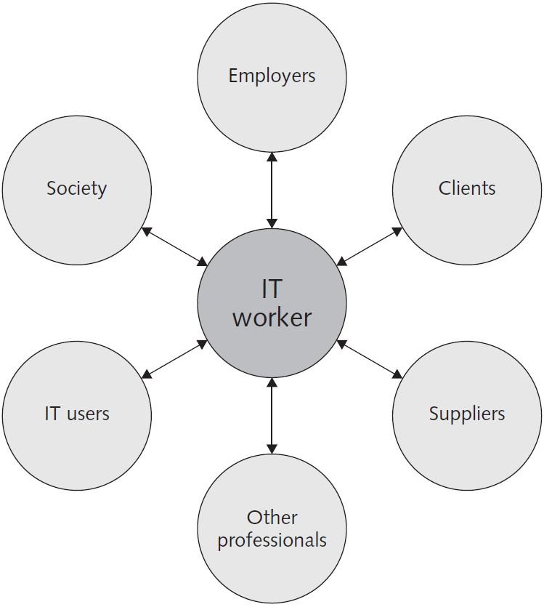
Professional Relationships IT Workers Must Manage
In each relationship, an ethical IT worker acts honestly and appropriately

Slide 8
Relationships Between IT Workers & Employers
Requires ongoing effort by both parties to keep it strong
Typically, fundamental aspects of the relationship are agreed on before the worker accepts an employment offer, i.e. job title, general performance expectations, specific work responsibilities, drug-testing requirements, dress code, location of employment, salary, work hours, and company benefits
Many other aspects of this relationship may be addressed in a company’s policy and procedures manual or in the company’s code of conduct, if one exists, i.e. protection of company secrets; vacation policy; time off for a funeral or an illness in the family; tuition reimbursement; and use of company resources, including computers and networks.

Slide 9
Relationships Between IT Workers & Employers
Other aspects of this relationship develop over time as the need arises i.e. leaving early
some days
Some aspects are addressed by law, i.e. an employee cannot be required to do anything illegal, such as falsify the results of a quality assurance test
Some aspects are specific to the role of the IT worker and are established based on the nature of the work or project, i.e. the programming language to be used, the type and amount of documentation to be produced, and the extent of testing to be conducted.

Slide 10
Ethical Issues Between IT Workers & Employers
Software piracy – IT workers may allow it or actively engage in it!
Business Software Alliance (BSA): Trade group that represents the world’s largest
software and hardware manufacturers.
Aims to stop the unauthorized copying of software.
Trade secret
Information that is of economic value and that has required effort or cost to develop and has some degree of uniqueness or novelty.
Companies often require employees to sign confidentiality agreements and promise not to reveal the company’s trade secrets.
Whistle-blowing
Effort by an employee to attract attention to a negligent, illegal, unethical, or
abusive act by a company that threatens the public interest.

Slide 11
Example of Software Piracy Case
In 2012, the Alexander Automotive Group paid $325,000 to settle claims that it was using unlicensed Microsoft software on its computers. As part of the settlement agreement with BSA, the firm deleted all unlicensed copies of software from its computers, purchased the licenses required to become compliant, and agreed to implement more effective software management procedures. BSA was alerted to this situation by a report sent to its Web site.

Slide 12
Ethical Issues Between IT Workers & Clients
Conflict of interest
Conflict between the IT worker’s self-interest and the interests of the client
Fraud
Obtaining goods, services, or property through deception or trickery
Misrepresentation
Misstatement or incomplete statement of a material fact
Breach of contract
Occurs when one party fails to meet the terms of a contract
Material breach of contract
Occurs when a party fails to perform certain obligations, thereby impairing or destroying the essence of the contract

Slide 13
Example of Conflict of Interest
For example, an IT consulting firm might be hired to assess a firm’s IT strategic plan. After a few weeks of analysis, the consulting firm might provide a poor rating for the existing strategy and insist that its proprietary products and services are required to develop a new strategic plan. Such findings would raise questions about the vendor’s objectivity and whether its recommendations can be trusted.

Slide 14
Example of Fraud - Paul Ceglia vs. Mark Zuckerberg
Paul Ceglia 2010 sued Facebook claiming to own a majority of the
company.
Ceglia claimed that he signed a contract with Mark Zuckerberg in 2003 to design and develop the Web site that eventually became Facebook.
But a judge dismissed his claims and prosecutors filed fraud charges after a forensic analysis of his computers and Harvard's email archive determined he had altered an unrelated contract and falsified emails to make it appear Zuckerberg had promised him a half-share.

Slide 15
Example of Fraud - Paul Ceglia vs. Mark Zuckerberg
Ceglia and his family (and his dog) were found to have vanished on May 1, 2015 after
he cut off a GPS tracker and he is being sought by law enforcement agencies.
“Everyone including our dog is happy and in good health. It has been a difficult and scary year for Iasia and I, but faith in God has seen us through and a determination to get justice has inspired me to keep going”.
He sent this email in 2016

Slide 16


Slide 17

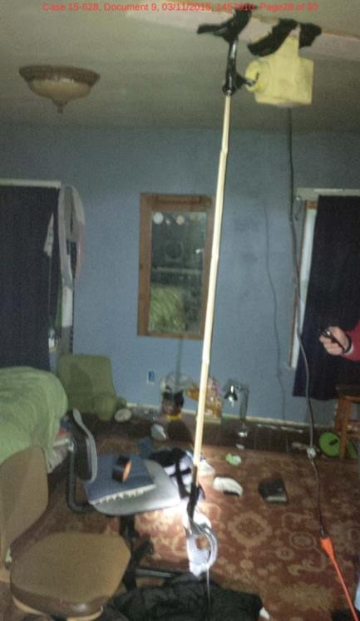

Slide 18
To Prove Fraud
To prove fraud in a court of law, prosecutors must demonstrate the following
elements:
The wrongdoer made a false representation of material fact.
The wrongdoer intended to deceive the innocent party.
The innocent party justifiably relied on the misrepresentation.
The innocent party was injured.

Slide 19
Misrepresentation Case
Siri, the voice-activated software that comes with the Apple iPhone, has delighted many iPhone users; however, not everyone has had a positive experience. Shortly after one user in New York purchased an iPhone 4S, he realized that Siri was not performing as expected. When he asked Siri for directions, it did not understand the question or after a long delay gave incorrect directions. As a result, the user filed a lawsuit against Apple claiming that advertising for the Siri amounted to “intentional misrepresentation” and that Apple’s claims about the Siri software were “misleading and deceptive.” Attorneys for this user are considering turning the case into a class action against Apple

Slide 20
End of lecture

Slide 21
When IT projects Go Wrong
When IT projects go wrong because of cost overruns, schedule slippage, lack of system functionality, and so on, aggrieved parties might charge fraud, fraudulent misrepresentation, and/or breach of contract.
Trials can take years to settle, generate substantial legal fees, and create bad publicity for both parties.
As a result, the vast majority of such disputes are settled out of court, and the proceedings and outcomes are concealed from the public. In addition, IT vendors have become more careful about protecting themselves from major legal losses by requiring that contracts place a limit on potential damages (Limitation Of Liability Clause).

Slide 22
When IT projects Go Wrong
Most IT projects are joint efforts in which vendors and customers work together to develop a system. Assigning fault when such projects go wrong can be difficult; one side might be partially at fault, while the other side is mostly at fault. Clients and vendors often disagree about who is to blame in such circumstances. Consider the following frequent causes of problems in IT projects:
The customer changes the scope of the project or the system requirements.
Poor communication between customer and vendor leads to performance that does not meet expectations.
The vendor delivers a system that meets customer requirements, but a competitor comes out with a system that offers more
advanced and useful features.
The customer fails to reveal information about legacy systems or databases that make the new system extremely difficult to implement.

Slide 23
Limitation Of Liability Clause In Contracts
Used to place a limit on potential damages
The limitation of liability clause restricts the amount and type of damages that one party can recover from another.
Example 1:"In no event shall either party be liable for any consequential damages, even if
either party knew or should have known of the possibility thereof."
Example 2: "In no event shall a party's liability to the other party for direct damages exceed an amount equal to the greater of (1) three times the amount of fees paid by Customer to Vendor under this Agreement; and (2) $1,000,000."

Slide 24
Ethical Issues Between IT Workers & Suppliers
Bribery: Providing money, property, or favors to someone in business or government in order to obtain a business advantage
The United Nations Convention Against Corruption - Global treaty designed to fight bribery and corruption

Slide 25
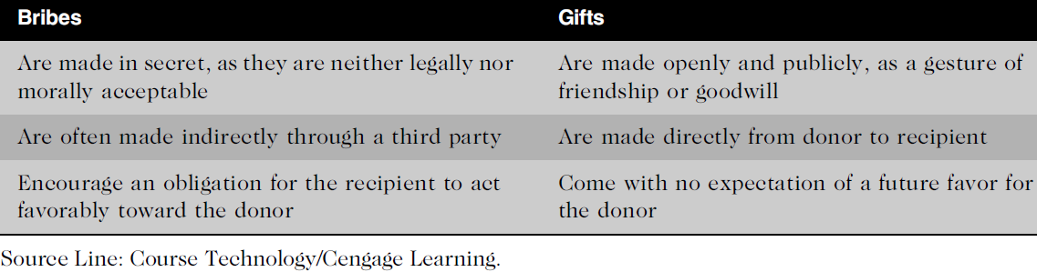
At what point does a gift become a bribe, and who decides?

Slide 26
Ethical Issues Between IT Workers & Other Professionals
Professionals owe each other adherence to their profession’s code of conduct
Ethical problems among the IT profession
Résumé inflation: Lying on a résumé about one’s qualifications – example Thompson and Yahoo
Inappropriate sharing of corporate information
Information may be sold or shared informally to third parties

Slide 27
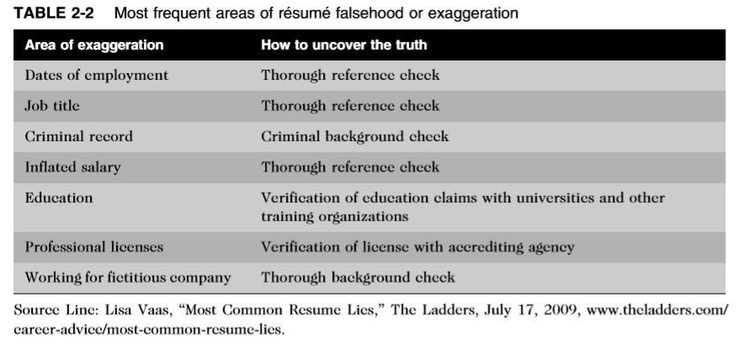
Résumé Inflation

Slide 28
Relationships Between IT Workers & IT Users
IT user refers to a person who uses a hardware or software product
IT users need the product to deliver organizational benefits or to increase their productivity.
IT workers have a duty to
Understand a user’s needs and capabilities to deliver products and services that best meet those needs to budget and time constraints
Establish an environment that supports ethical behavior by users. Such an environment discourages software piracy, minimizes the inappropriate use of corporate computing resources, and avoids the inappropriate sharing of information

Slide 29
Relationships Between IT Workers & Society
Society expects members of a profession to:
Provide significant benefits
Not cause harm through their actions
Professional organizations provide codes of ethics to guide IT workers’ actions

Slide 30
Professional Code Of Ethics
A professional code of ethics states the principles and core values that are essential to the
work of a particular occupational group.
Practitioners in many professions subscribe to a code of ethics that governs their behaviour
Most codes of ethics created by professional organizations have two main parts:
Outlines what the organization aspires to become, and
Lists rules and principles by which members of the organization are expected to abide.
Many codes also include a commitment to continuing education for those who practice the profession.

Slide 31
Professional Code Of Ethics
Laws do not provide a complete guide to ethical behavior.
Just because an activity is not defined as illegal does not mean it is ethical.
Nor can a professional code of ethics be expected to provide an answer to every ethical dilemma—no code can be a definitive collection of behavioral standards.
However, following a professional code of ethics can produce many benefits for the individual, the profession, and society as a whole

Slide 32
Professional Code Of Ethics Helps In:
Ethical decision making
Adherence to a professional code of ethics means that practitioners use a common set of core values and beliefs as a
guideline for ethical decision making.
High standards of practice and ethical behavior
Adherence to a code of ethics reminds professionals of the responsibilities and duties that they may be tempted to
compromise to meet the pressures of day-to-day business.
The code also defines acceptable and unacceptable behaviors to guide professionals in their interactions with others.
Strong codes of ethics have procedures for censuring professionals for serious violations, with penalties that can include the loss of the right to practice.

Slide 33
Professional Code Of Ethics Helps In:
Trust and respect from the general public
Adherence to a code of ethics enhances trust and respect for professionals and their profession.
Public trust is built on the expectation that a professional will behave ethically.
People must often depend on the integrity and good judgment of a professional to tell the truth, abstain from giving self-serving advice, and offer warnings about the potential negative side effects of their actions.
Evaluation benchmark for self-assessment
A code of ethics provides an evaluation benchmark that a professional can use as a means of self-assessment.
Peers of the professional can also use the code for recognition or censure.

Slide 34
Professional Organizations
In order to stay on top of the many new developments in their field, IT workers need to:
Network with others,
Seek out new ideas, and
Continually build on their personal skills and expertise
Professional organizations help IT workers to network with others, seek out new
ideas, and continually build on their personal skills and expertise
Four of the most prominent IT-related professional organization
Association for Computing Machinery (ACM)
Institute of Electrical and Electronics Engineers Computer Society (IEEE-CS)
Association of Information Technology Professionals (AITP)
SysAdmin, Audit, Network, Security (SANS) Institute

Slide 35
Assignment 4
Choose two codes of ethics of two of these organizations (ACM, IEEE, AITP, or SANS) write a review, criticize, and compare them showing the strongest and weakest points in each of them
review
comparison
strongest points
weakest points
write a minimum of 600 words for the whole report
±10%

Slide 36
Assignment 4
Association for Computing Machinery (ACM) link:
https://www.acm.org/code-of-ethics
Institute of Electrical and Electronics Engineers Computer Society (IEEE‐CS) link: https://www.computer.org/web/education/code-of-ethics
Association of Information Technology Professionals (AITP) link:
https://sites.google.com/a/gmatc.matc.edu/aitp/code-of-ethics
SysAdmin, Audit, Network, Security (SANS) Institute link: https://www.sans.org/security-resources/ethics

Slide 37
Certification
Certification indicates that a professional possesses a particular set of skills, knowledge, or abilities, in the opinion of the certifying organization.
Obliges an individual to have the prerequisite education and experience, and to sit for and pass an exam
Certifications from industry associations requires a higher level of experience and a broader perspective than vendor certifications
Unlike licensing, which applies only to people and is required by law, certification can also apply to products and is generally voluntary.
IT-related certifications may or may not include a requirement to adhere to a code of ethics, whereas such a requirement is standard with licensing.

Slide 38
Certifications In High Demand
Certified in Risk and Information Systems Control (CRISC)
Certified Information Security Manager (CISM)
AWS Certified Solutions Architect – Associate
Certified Information Systems Security Professional (CISSP)
Certified Information Systems Auditor (CISA)
Project Management Professional (PMP)
Citrix Certified Professional – Virtualization (CCP-V)
src: https://www.pcmag.com/article/345434/the-7-highest-paying-it-certifications

Slide 39
Certifications In High Demand
Certified in Risk and Information Systems Control (CRISC)
Certified Information Security Manager (CISM)
AWS Certified Solutions Architect - Associate
Certified Information Systems Security Professional (CISSP)
Project Management Professional (PMP)
src: https://www.techrepublic.com/article/the-top-5-it-certifications-that-will-increase-your-salary/

Slide 40
Impact of Government Licensing on Ethical Behaviour
Government license: permission to engage in an activity or to operate a business
Licensing IT workers, would it make a difference?
Licensing would strongly encourage IT workers to follow the highest standards of the profession and practice a code of ethics
Allows for violators to be punished
Without licensing, there are no clear, well defined requirements for heightened care and no concept of professional malpractice.

Slide 41
IT Professional Malpractice
Negligence: Not doing something that a reasonable person would do, or doing something that a reasonable person would not do
Professional negligence can only occur when people fail to perform within the standards of their profession, and software engineering is not a uniformly licensed profession in some countries.
Because there are no uniform standards against which to compare a software engineer’s professional behavior, he or she cannot be subject to malpractice lawsuits
Duty of care refers to the obligation to protect people against any unreasonable harm or risk.
For example, people have a duty to keep their pets from attacking others and to operate their cars safely. Similarly, businesses must keep dangerous pollutants out of the air and water, make safe products, and maintain safe operating conditions for employees
Failure results in breach of the duty of care

Slide 42
IT Professional Malpractice
The courts decide whether parties owe a duty of care by applying a reasonable person standard to evaluate
how an objective, careful, and conscientious person would have acted in the same circumstances
Defendants who have particular expertise or competence are measured against a reasonable professional standard.
For example, in a medical malpractice suit based on improper treatment of a broken bone, the standard of measure would be higher if the defendant were an orthopedic surgeon rather than a general practitioner.
In the IT arena, consider a hypothetical negligence case in which an employee inadvertently destroyed millions of customer records in an Oracle database. The standard of measure would be higher if the defendant were a licensed, Oracle certified database administrator (DBA) with 10 years of experience rather than an unlicensed systems analyst with no DBA experience or specific knowledge of the Oracle software.

Slide 43
IT Professional Malpractice
A breach of the duty of care is the failure to act as a reasonable person would act. A breach of duty might consist of:
an action, such as throwing a lit cigarette into a fireworks factory and causing an explosion, or
a failure to act when there is a duty to do so—for example, a police officer not protecting a citizen from an attacker
Professionals who breach the duty of care are liable for injuries that their negligence causes. This liability is commonly referred to as professional malpractice.
For example, a Certified Public Accountants (CPA) who fails to use reasonable care, knowledge, skill, and judgment when auditing a client’s books is liable for accounting malpractice.
Professionals who breach this duty are liable to their patients or clients, and possibly to some third
parties

Slide 44
Common Ethical Issues for IT Users
Software piracy
Popularity of the Android smartphone operating system has contributed to the software piracy problem
Some IT end users have figured out how to download applications from the Android Market Web site without paying for them, and then use the software or sell it to others. One legitimate Android application developer complained that his first application was pirated within a month and that the number of downloads from the pirate’s site were greater than his own. Professional developers become discouraged as they watch their sales sink while pirates’ sales rocket.

Slide 45
Common Ethical Issues for IT Users
Inappropriate use of computing resources
Erode worker productivity and waste time
Could lead to lawsuits
Inappropriate sharing of information
Violation of someone’s privacy, if its private data
Potential that company information could fall into the hands of competitors, in the case of confidential information

Slide 46
Policies
Supporting the Ethical Practices of IT Users
Policies that protect against abuses help:
Set forth general rights and responsibilities of all users
Establish boundaries of acceptable behavior
Enable management to punish violators
Policy components include:
Establishing guidelines for use of company software
Defining appropriate use of IT resources
Structuring information systems to protect data and information

Slide 47
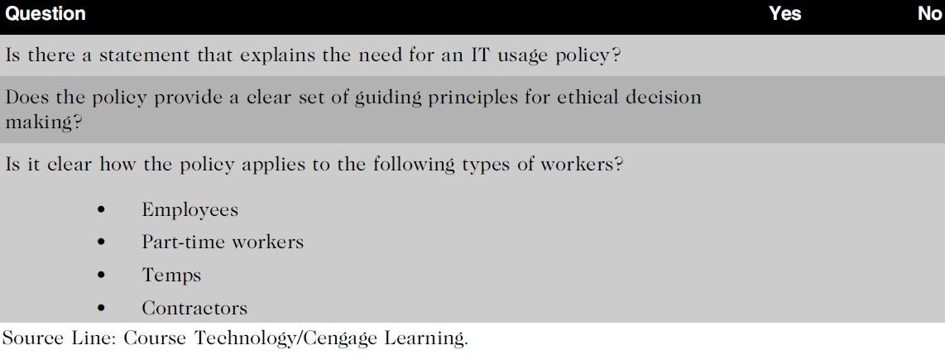
Manager’s Checklist for Establishing an IT Usage Policy

Slide 48
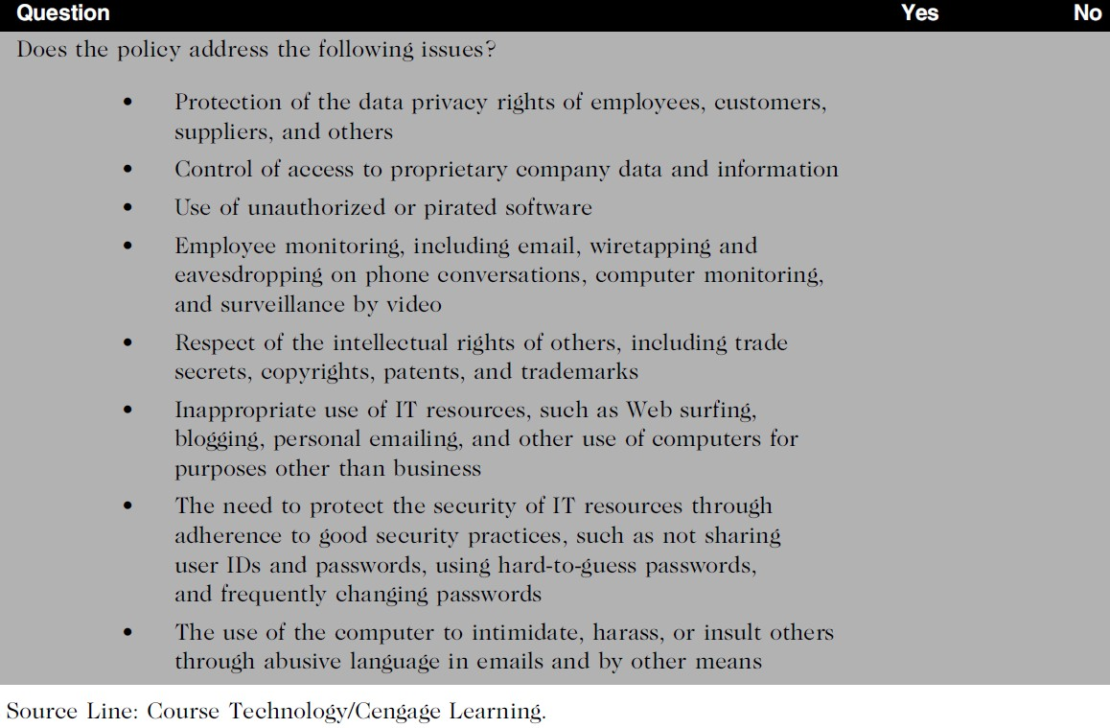
Supporting the Ethical Practices of IT Users

Slide 49
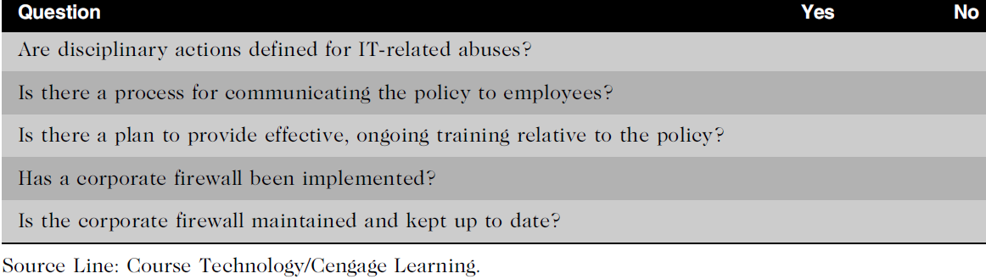
Supporting the Ethical Practices of IT Users

Slide 50
Compliance
To be in accordance with established policies, guidelines, specifications, or legislation
Requires an individual to behave in accordance with legislation such as the Sarbanes–
Oxley Act of 2002 for accounting
Failure to be in compliance with legislation can lead to lawsuits or government fines
To ensure compliance, companies:
Implement software to track and record compliance actions
Hire management consultants for advice and training
Create the position of chief compliance officer (CCO), to deal with the issues related to compliance

Slide 51
Compliance
Audit committee: board of directors provides assistance to the board with respect to the:
Quality and integrity of accounting and reporting practices and controls
Organization’s compliance with legal and regulatory requirements
Qualifications, independence, and performance of the organization’s
independent auditor
Performance of the company’s internal audit team

Slide 52
Compliance
Internal audit committee responsibilities:
Determine that internal systems and controls are adequate and effective
Verify existence of company assets and maintain proper safeguards over their protection
Measure the organization’s compliance with its own policies and procedures
Ensure that institutional policies and procedures, appropriate laws, and good practices are followed
Evaluate adequacy and reliability of information available for management
decision making

Slide 53
Summary
Professionals
Require advanced training and experience
Must exercise discretion and judgment in their work
Their work cannot be standardized
From a legal standpoint, a professional:
Has passed the state licensing requirements
Has earned the right to practice in a state(s)
IT professionals have many different relationships
Each with its own ethical issues and potential problems
Professional code of ethics
States the principles and core values essential to the work of an occupational group
Serves as a guideline for ethical decision making
Promotes high standards of practice and behavior
Enhances trust and respect from the general public
Provides an evaluation benchmark

Slide 54
Summary
Licensing and certification of IT professionals
Increases the reliability and effectiveness of information systems
IT-related professional organizations have developed their code of ethics that:
Outlines what the organization aspires to become
Lists rules and principles for members
Includes a commitment to continuing education for those who
practice the profession
Audit committee and internal audit team have a major role in ensuring that both the IT organization and IT users are in

